Slide 1
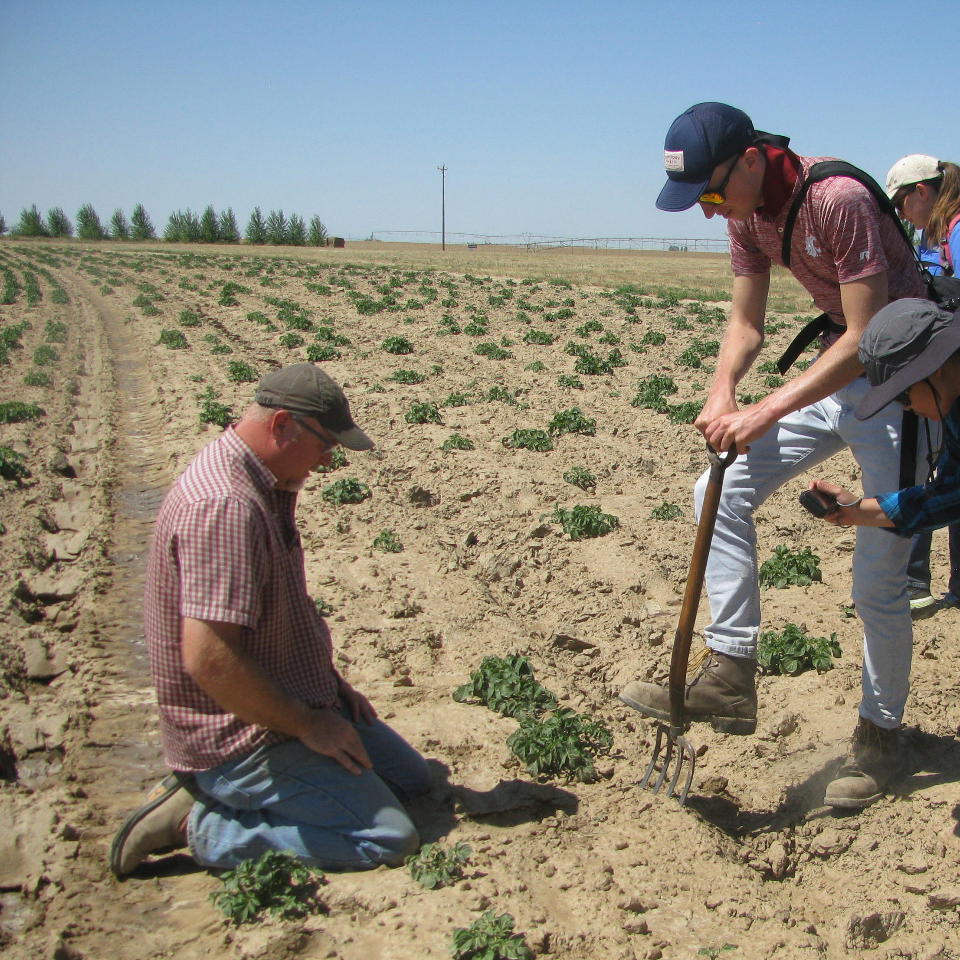

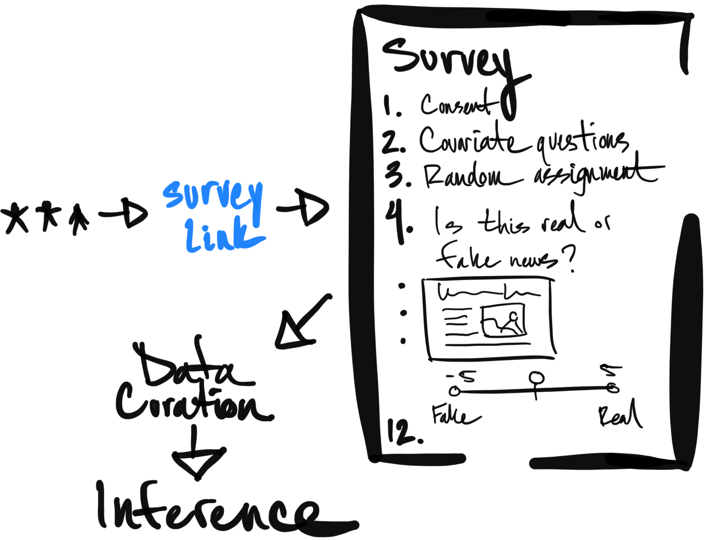
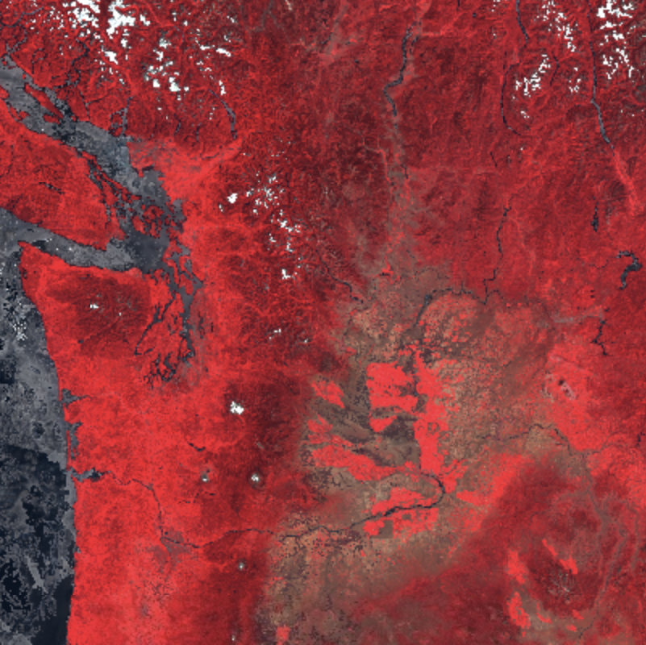
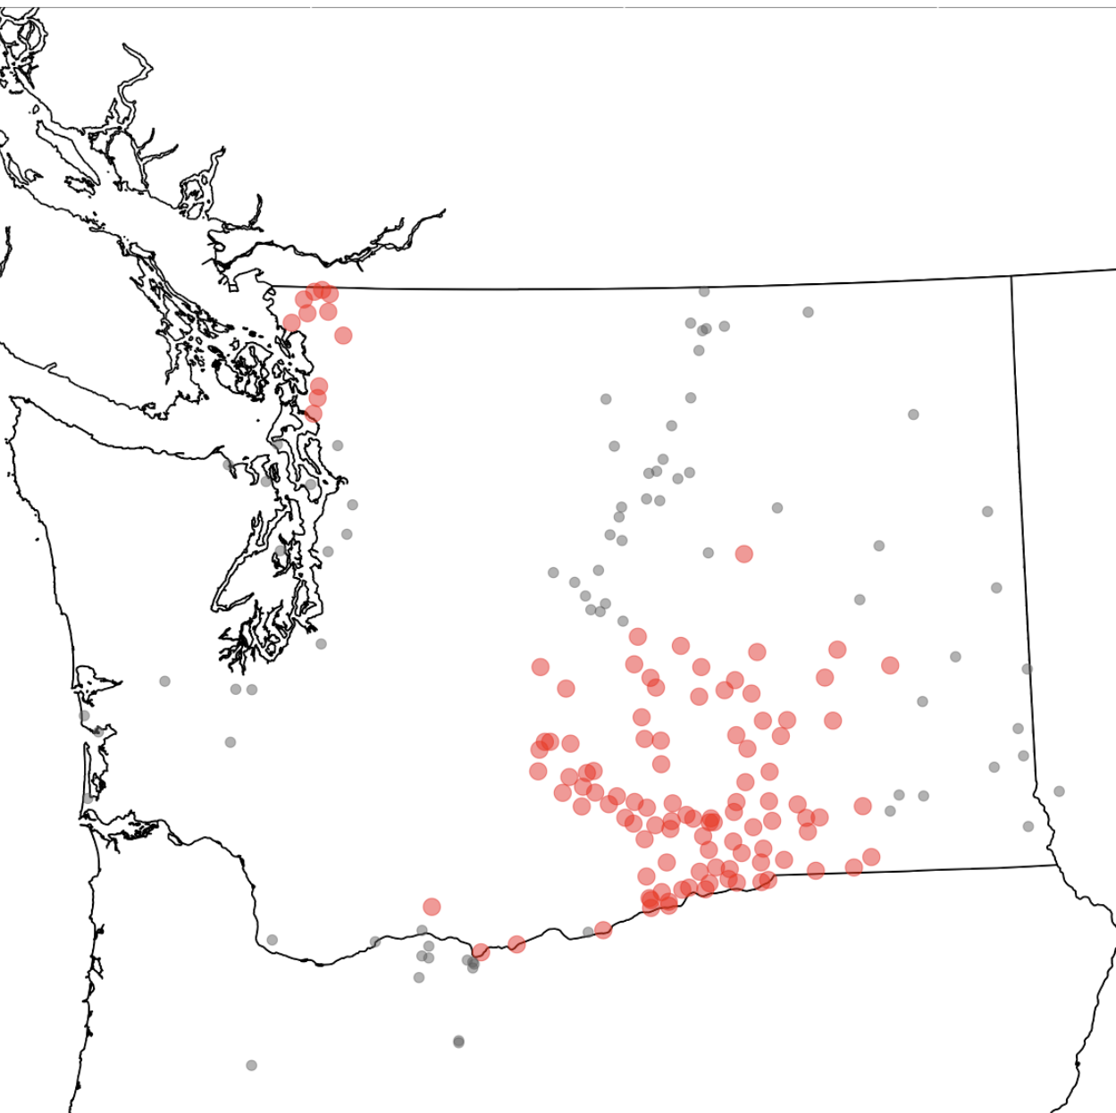
A
G
outreach
B
E
F
H
machine
learning
models
journal article
forecasts
C
I
extension
bulletins
D

Slide 2
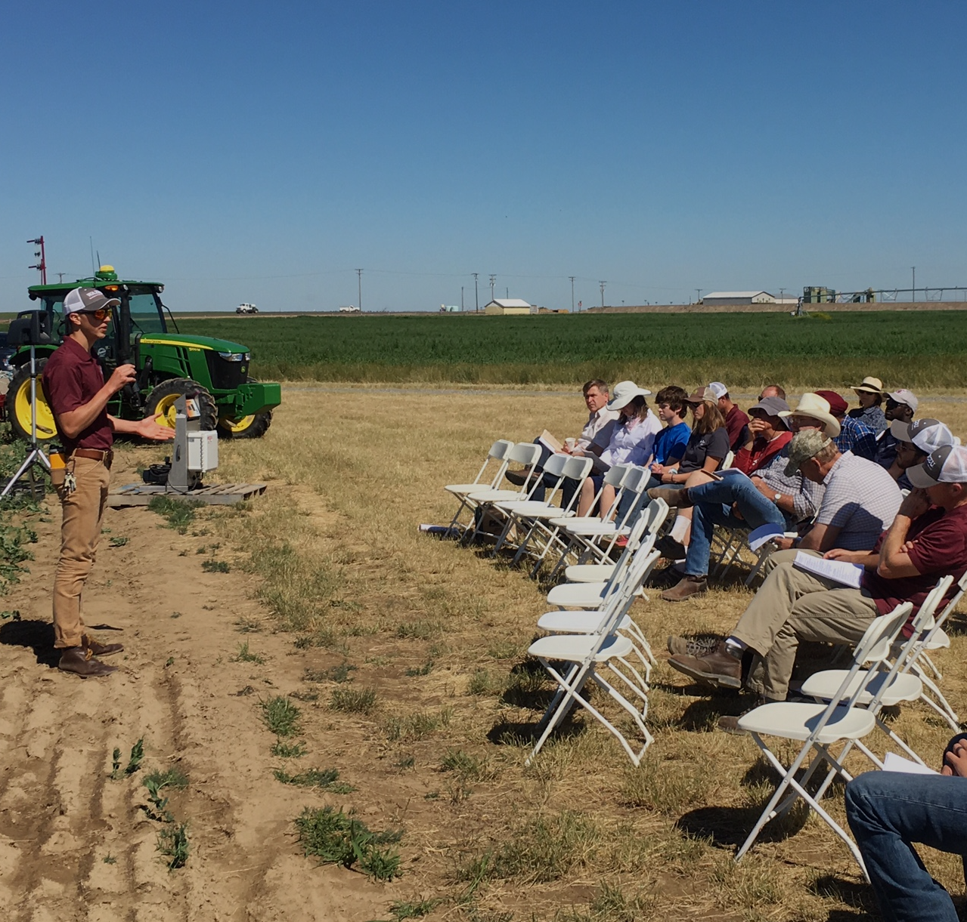

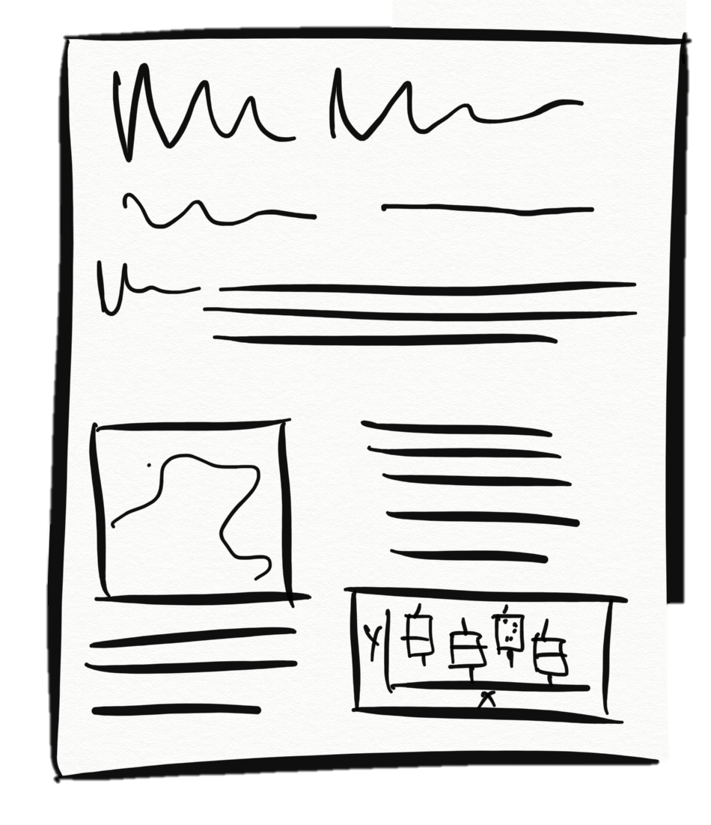
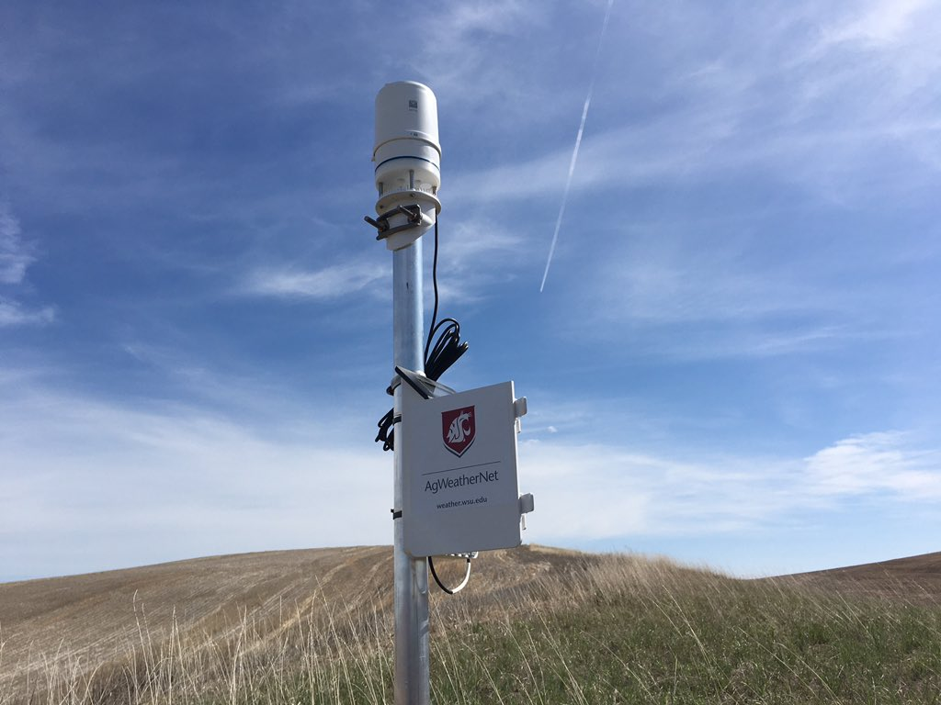
A
G
B
outreach
E
F
H
machine
learning
models
journal article
forecasts
journal article
C
I
extension
bulletins
extension
bulletins
D

Slide 3
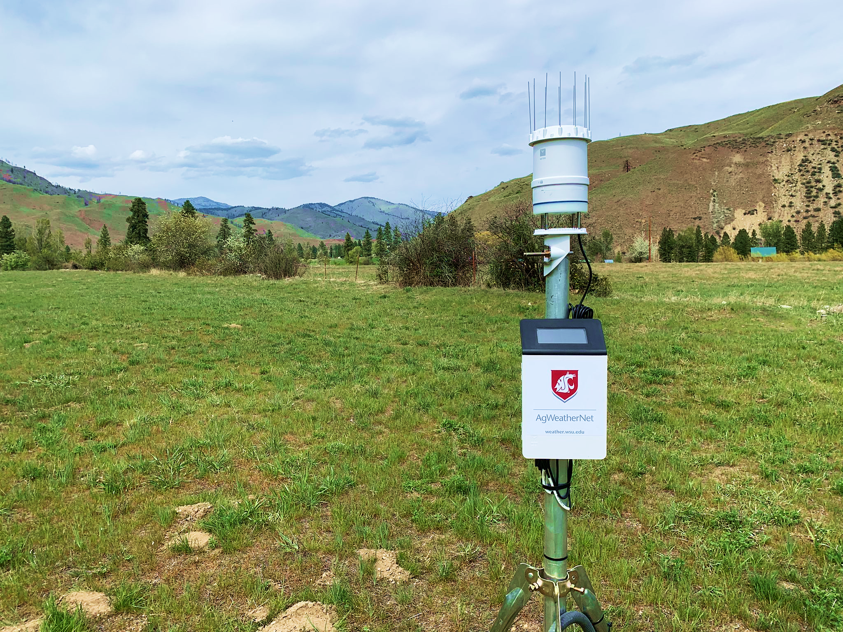
A
G
B
outreach
E
F
H
machine
learning
models
journal article
forecasts
journal article
C
I
extension
bulletins
extension
bulletins
D

